Slide 1

SurgeProtector: Mitigating Temporal Algorithmic Complexity Attacks on NFs Using Adversarial Scheduling
Nirav Atre, Hugo Sadok, Erica Chiang, Weina Wang, Justine Sherry

Slide 2




Network Functions (NFs)
NFs are key components of the Internet infrastructure
Firewalls, load-balancers, intrusion prevention systems (IPS), etc.
…and prime targets for Denial-of-Service (DoS) attacks!

Slide 3
Denial-of-Service Attacks
Goal: Consume as much of a target system’s resources as possible, inhibiting its ability to serve legitimate users

Slide 4



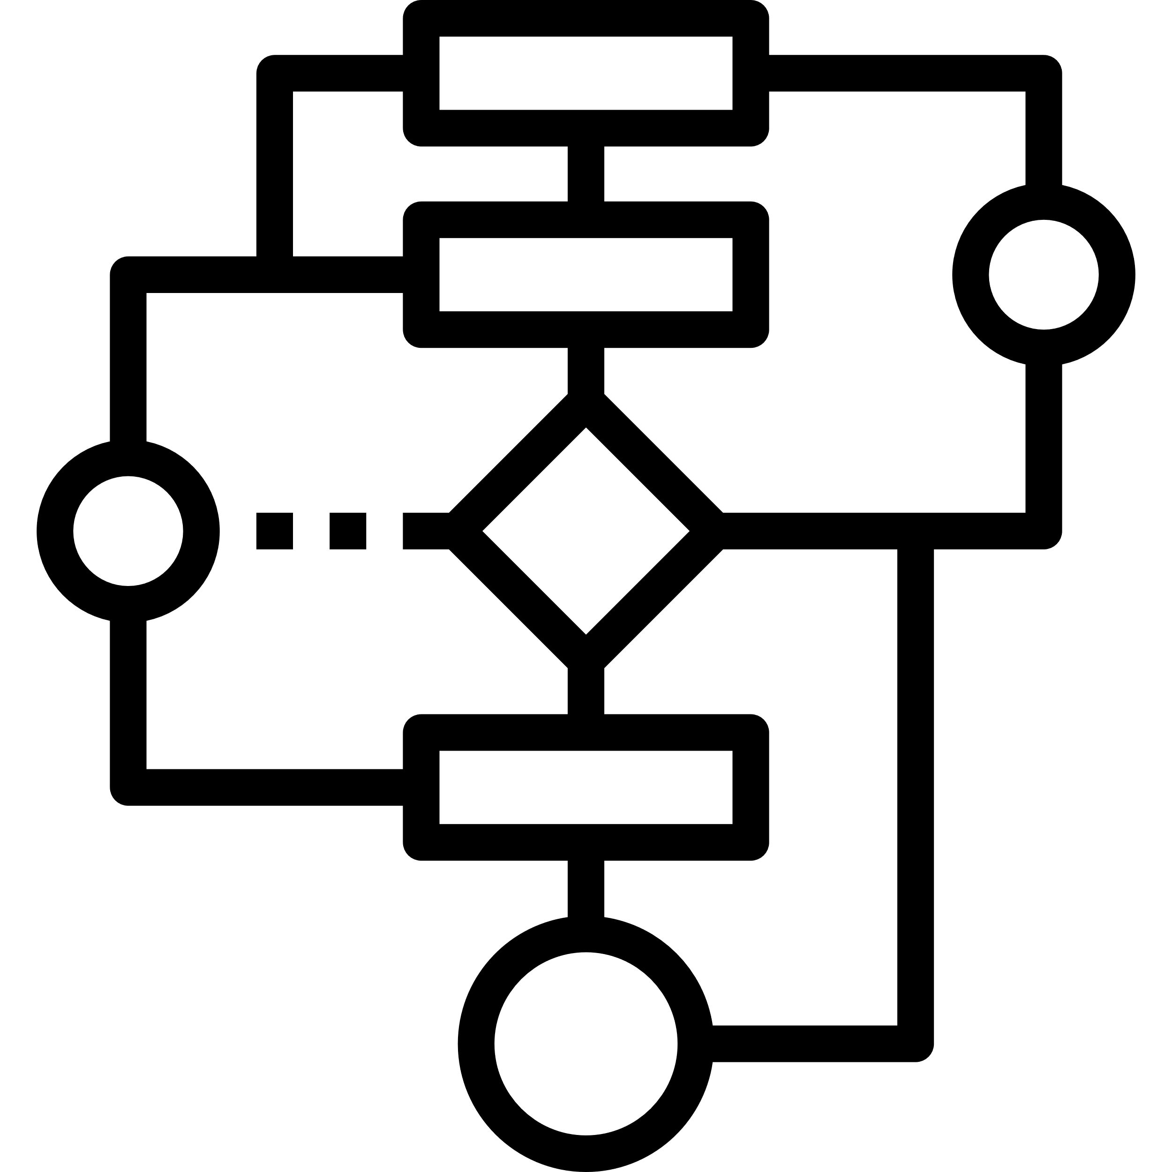

DoS: Algorithmic Complexity Attacks (ACAs)
Worst-case input
Attacker
NF (Victim)
Algorithm
(Worst case time-complexity >
Average-case time-complexity)
Innocent Users

Slide 5


DoS: Algorithmic Complexity Attacks (ACAs)
Worst-case input
Attacker
NF (Victim)
Algorithm
(Worst case time-complexity >
Average-case time-complexity)
Innocent Users
Several NFs are inherently vulnerable to ACAs, e.g.: TCP reassembly, regex-based DPI, exact packet classification (TSS), decompression, etc.

Slide 6
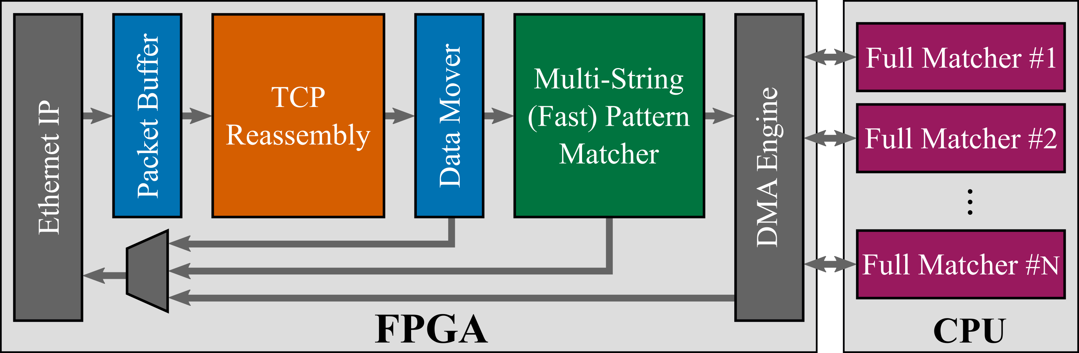
Pigasus: FPGA-based IDS capable of 100Gbps
❶
❷
Two ACA vulnerabilities:
❶ Reassembler can be attacked using highly out-of-order TCP flows
❷ CPU-side Full Matcher (Regex) is vulnerable to ReDoS-style attacks

Slide 7
Example: TCP Reassembly
Sometimes, packets arrive out-of-order. Reassembly puts them back in order.
[500, 1000)
“Packet holes”
A
[100, 500)
[1000, 1400)
User A
[72, 73)
B
[1, 2)
[3, 4)
[5, 6)
[7, 8)
…
[70, 71)
User B
Adversary induces a lot of work using very few, small packets!

Slide 8
ACA vulnerabilities are not bugs
→ Artifacts of perfectly reasonable design choices
…so how do we “fix” them?

Slide 9
This Talk
Modeling ACAs on NFs and quantifying their impact
How does one defend against ACAs?
Evaluation

Slide 10
This Talk
Modeling ACAs on NFs and quantifying their impact
How does one defend against ACAs?
Evaluation

Slide 11
System Model
N
e
t
w
o
r
k
F
u
n
c
t
i
o
n
r
G
b
p
s
I
O
u
t
p
u
t
I
n
g
r
e
s
s
L
i
n
k
(
l
i
n
e
-
r
a
t
e
:
R
G
b
p
s
)

Slide 12
System Model
N
e
t
w
o
r
k
F
u
n
c
t
i
o
n
o
G
b
p
s
r
G
b
I
p
s
I
O
u
t
p
u
t
I
n
g
r
e
s
s
L
i
n
k
(
l
i
n
e
-
r
a
t
e
:
R
G
b
p
s
)

Slide 13
System Model
r
G
b
p
s
A
N
e
t
w
o
r
k
F
u
n
c
t
i
o
n
o
G
b
p
s
r
G
b
I
p
s
I
O
u
t
p
u
t
I
n
g
r
e
s
s
L
i
n
k
(
l
i
n
e
-
r
a
t
e
:
R
G
b
p
s
)

Slide 14
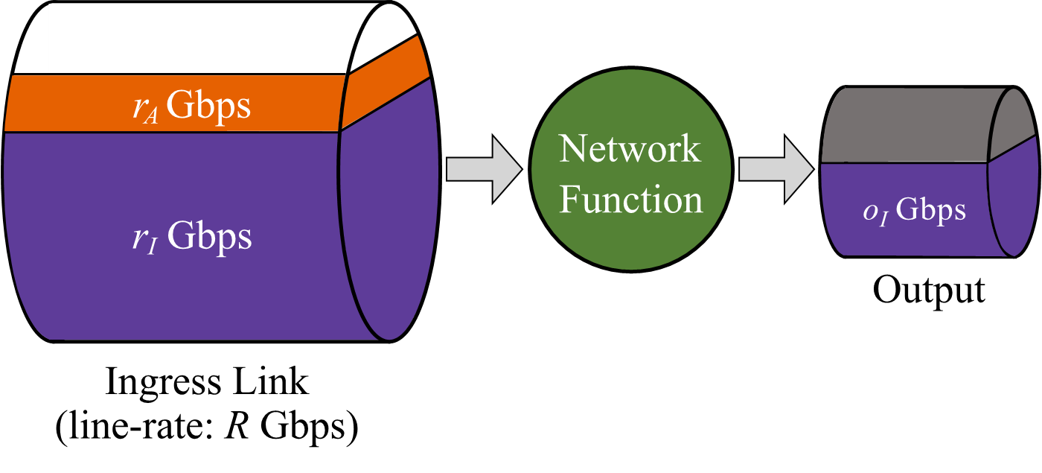
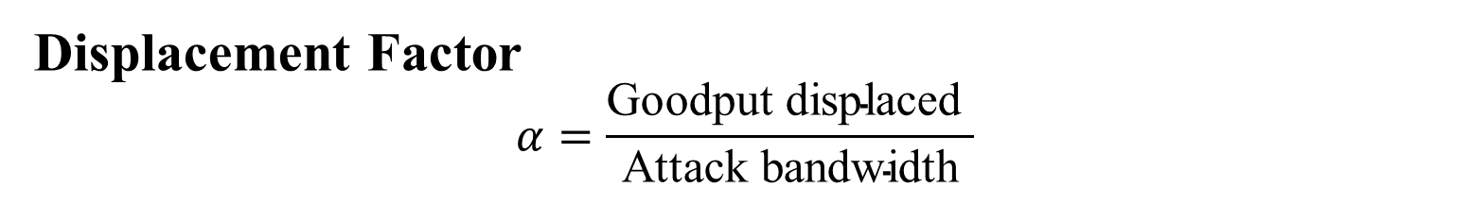
Quantifying the impact of ACAs
Displacement Factor
$$α=\frac{\text{Goodput} \text{displaced} }{\text{Attack} \text{bandwidth}}$$
Adversary’s goal: Displace as much innocent traffic as possible (“harm”) using as little attack bandwidth as possible (“effort”).

Slide 15
This Talk
Modeling ACAs on NFs and quantifying their impact
How does one defend against ACAs?
Evaluation

Slide 16
Existing approaches
Resource Isolation: give every user a fixed slice of service time
  In the networking setting, this means Fair Queueing
Application-specific patches
  “Patch” algorithm so worst-case is not too bad
Doesn’t work in an adversarial setting
A
[100, 500)
[1000, 1400)
[1800, 2200)
[1400, 2000)
Limits serviceable traffic or sacrifices performance in common case

Slide 17
Is there a “general” approach to ACA mitigation that does not limit traffic or throttle common-case performance?
Key insight: If we reorder packets just the right way, we can selectively de-prioritize attack traffic → Packet Scheduling!

Slide 18
Adversarial Scheduling
Policy
r
G
b
p
s
A
N
e
t
w
o
r
k
F
u
n
c
t
i
o
n
o
G
b
p
I
s
r
G
b
p
s
I
Output
I
Scheduler
n
g
r
e
s
s
L
i
n
k
(
l
i
n
e
-
r
a
t
e
:
R
G
b
p
s
)

Slide 19
How do traditional scheduling policies fare?
NFs typically use First-Come First-Served (FCFS, the de facto policy), or Fair Queueing variants (WFQ, DRFQ, etc.) to ensure flow-level fairness.
Q. How do these fare in an adversarial setting?

Slide 20
1. FCFS
Policy: Serve packets in the order that they arrive.
Innocent Users

Slide 21
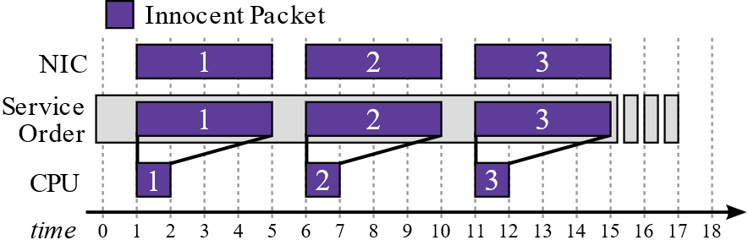

1. FCFS
Policy: Serve packets in the order that they arrive.
r_{I}
Innocent users
Innocent Users

Slide 22
1. FCFS
Policy: Serve packets in the order that they arrive.
Packet size (P_{A})
Job size (J_{A})
r_{A}
Attacker
r_{I}
Innocent users
Innocent Users

Slide 23
1. FCFS
Policy: Serve packets in the order that they arrive.
Maximize packet rate for given attack bandwidth
Packet size (P_{A}) | P_{min}
Job size (J_{A})
r_{A}
Attacker
r_{I}
Innocent users
Innocent Users

Slide 24
1. FCFS
Policy: Serve packets in the order that they arrive.
Maximize packet rate for given attack bandwidth
Packet size (P_{A}) | P_{min}
Job size (J_{A}) | J_{max}
Maximize work per packet
r_{A}
Attacker
r_{I}
Innocent users
Innocent Users

Slide 25
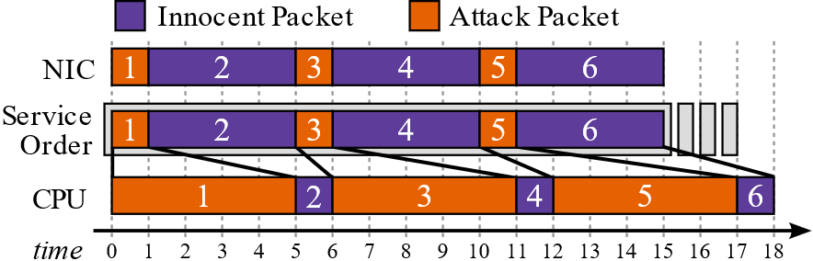
1. FCFS
Policy: Serve packets in the order that they arrive.
Packet size (P_{A}) | P_{min}
Job size (J_{A}) | J_{max}
r_{A}
Attacker
r_{I}
Innocent users
Innocent Users

Slide 26
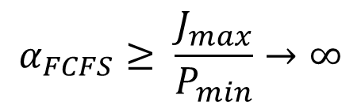
1. FCFS
$$α_{FCFS}≥ \frac{J_{max}}{P_{min}}→∞$$
FCFS has an unbounded DF
Policy: Serve packets in the order that they arrive.
Packet size (P_{A}) | P_{min}
Job size (J_{A}) | J_{max}
r_{A}
Attacker
r_{I}
Innocent users
Innocent Users

Slide 27
2. Fair Queueing (FQ)
Policy: Partition processor time equitably between flows.

Slide 28
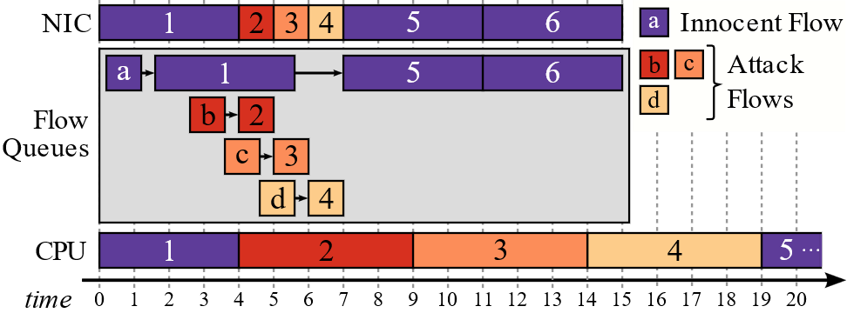
2. Fair Queueing (FQ)
Policy: Partition processor time equitably between flows.
Number of flows | ∞
Packet size (P_{A}) | P_{min}
Job size (J_{A}) | J_{max}
r_{A}
Attacker
r_{I}
Innocent users

Slide 29

2. Fair Queueing (FQ)
$$α_{FQ}≥ \frac{J_{max}}{P_{min}}→∞$$
FQ has an unbounded DF
Policy: Partition processor time equitably between flows.
Number of flows | ∞
Packet size (P_{A}) | P_{min}
Job size (J_{A}) | J_{max}
r_{A}
Attacker
r_{I}
Innocent users

Slide 30

How do existing scheduling policies fare?
NFs typically use First-Come First-Served (FCFS, the de facto policy), or Fair Queueing variants (WFQ, DRFQ, etc.) to ensure flow-level fairness.
Q. How do these fare in an adversarial setting?
Ans.

Slide 31
So, what can we do?
Intuition #1: It’s the large jobs (with size J_{max}) that are killing our Displacement Factor. Why don’t we prioritize small jobs?
Intuition #2: The packet size is useful information that we’re throwing away. We should incorporate that into our policy!

Slide 32
3. Packet-Size Weighted Shortest-Job First (WSJF)
Policy: Prioritize packets with the smallest $\frac{Job size}{Packet size}$ ratio.

Slide 33

3. Packet-Size Weighted Shortest-Job First (WSJF)
Policy: Prioritize packets with the smallest $\frac{Job size}{Packet size}$ ratio.

Slide 34
3. Packet-Size Weighted Shortest-Job First (WSJF)
Policy: Prioritize packets with the smallest $\frac{Job size}{Packet size}$ ratio.
Job size: 1

Slide 35
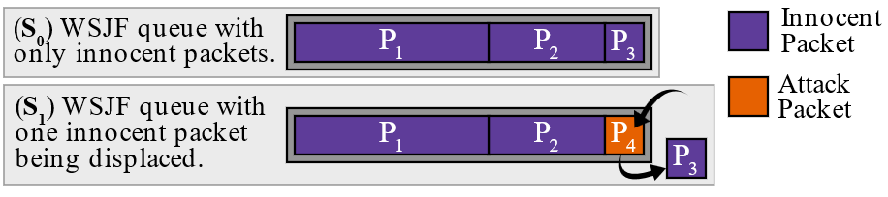
3. Packet-Size Weighted Shortest-Job First (WSJF)
Policy: Prioritize packets with the smallest $\frac{Job size}{Packet size}$ ratio.
Job size: 1

Slide 36
3. Packet-Size Weighted Shortest-Job First (WSJF)
Policy: Prioritize packets with the smallest $\frac{Job size}{Packet size}$ ratio.
Job size: 1
} P₄ ≥ P₃

Slide 37

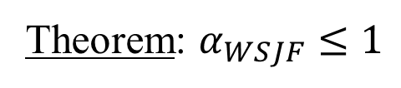
3. Packet-Size Weighted Shortest-Job First (WSJF)
Policy: Prioritize packets with the smallest $\frac{Job size}{Packet size}$ ratio.
Theorem: $α_{WSJF}≤1$
WSJF has a bounded constant DF!
For every 1 bit/sec of goodput the adversary wants to displace, they must invest at least 1 bit/sec of their own bandwidth into the attack.

Slide 38
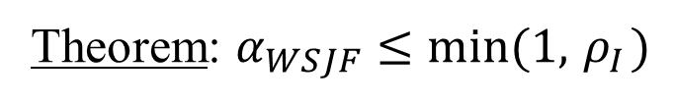
3. Packet-Size Weighted Shortest-Job First (WSJF)
Policy: Prioritize packets with the smallest $\frac{Job size}{Packet size}$ ratio.
Theorem: $α_{WSJF}≤min⁡(1, { ρ}_{I})$
For every 1 bit/sec of goodput the adversary wants to displace, they must invest at least 1 bit/sec of their own bandwidth into the attack.

Slide 39

3. Packet-Size Weighted Shortest-Job First (WSJF)
Policy: Prioritize packets with the smallest $\frac{Job size}{Packet size}$ ratio.
Theorem: $α_{WSJF}≤min⁡(1, { ρ}_{I})$
}
Load on NF due to innocent traffic $\left(\frac{r_{I}}{r_{max}}\right)$
For every 1 bit/sec of goodput the adversary wants to displace, they must invest at least 1 bit/sec of their own bandwidth into the attack.

Slide 40
SurgeProtector
Interposes a WSJF scheduler between the ingress link and NF, guaranteeing (in theory) an upper-bound of 1 on the worst-case DF.
Independent of the load on the NF, job and packet size distributions for innocent traffic, and the underlying application itself.

Slide 41
Dealing with practical issues
Unknown job sizes: in systems, the job size is rarely known a priori
  Use heuristics. Query the system for its best estimate of the packet’s service time and use that as a proxy
Keeping flows in-order: sometimes, packets of a single flow need to be served in arrival order (e.g. TCP applications)
  We designed an in-order variant of WSJF with similar properties
What if the adversary attacks the scheduler?
  We use a heap with guaranteed constant worst-case complexity (Hierarchical Find-First Set Queue). Implemented in both software and hardware (FPGA).

Slide 42
This Talk
Modeling ACAs on NFs and quantifying their impact
How does one defend against ACAs?
Evaluation

Slide 43
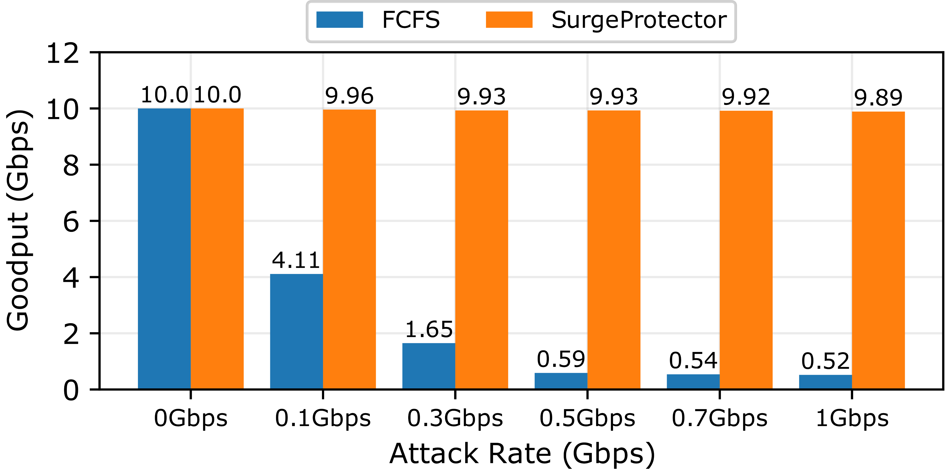
Evaluation: Pigasus’ TCP Reassembler
SurgeProtector yields a 99% reduction in goodput loss

Slide 44


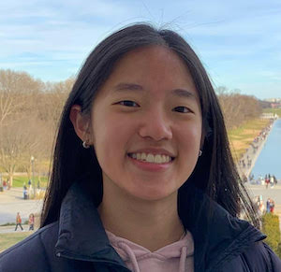


Conclusion
Network functions are susceptible to algorithmic complexity attacks (ACAs). We design SurgeProtector, a general mitigation framework that provably upper-bounds the amount of “harm” an adversary can induce via ACAs.
Open-source code: https://github.com/cmu-snap/SurgeProtector

Slide 45
Heuristics: TCP Reassembly
Estimated job size is the length of the out-of-order linked list for that flow
→ Upper-bounds the true job size
A
[100, 500)
[1000, 1400)
Est. job size: 2
User A
B
[1, 2)
[3, 4)
[5, 6)
[7, 8)
…
[71, 72)
Est. job size: 36
User B

Slide 46
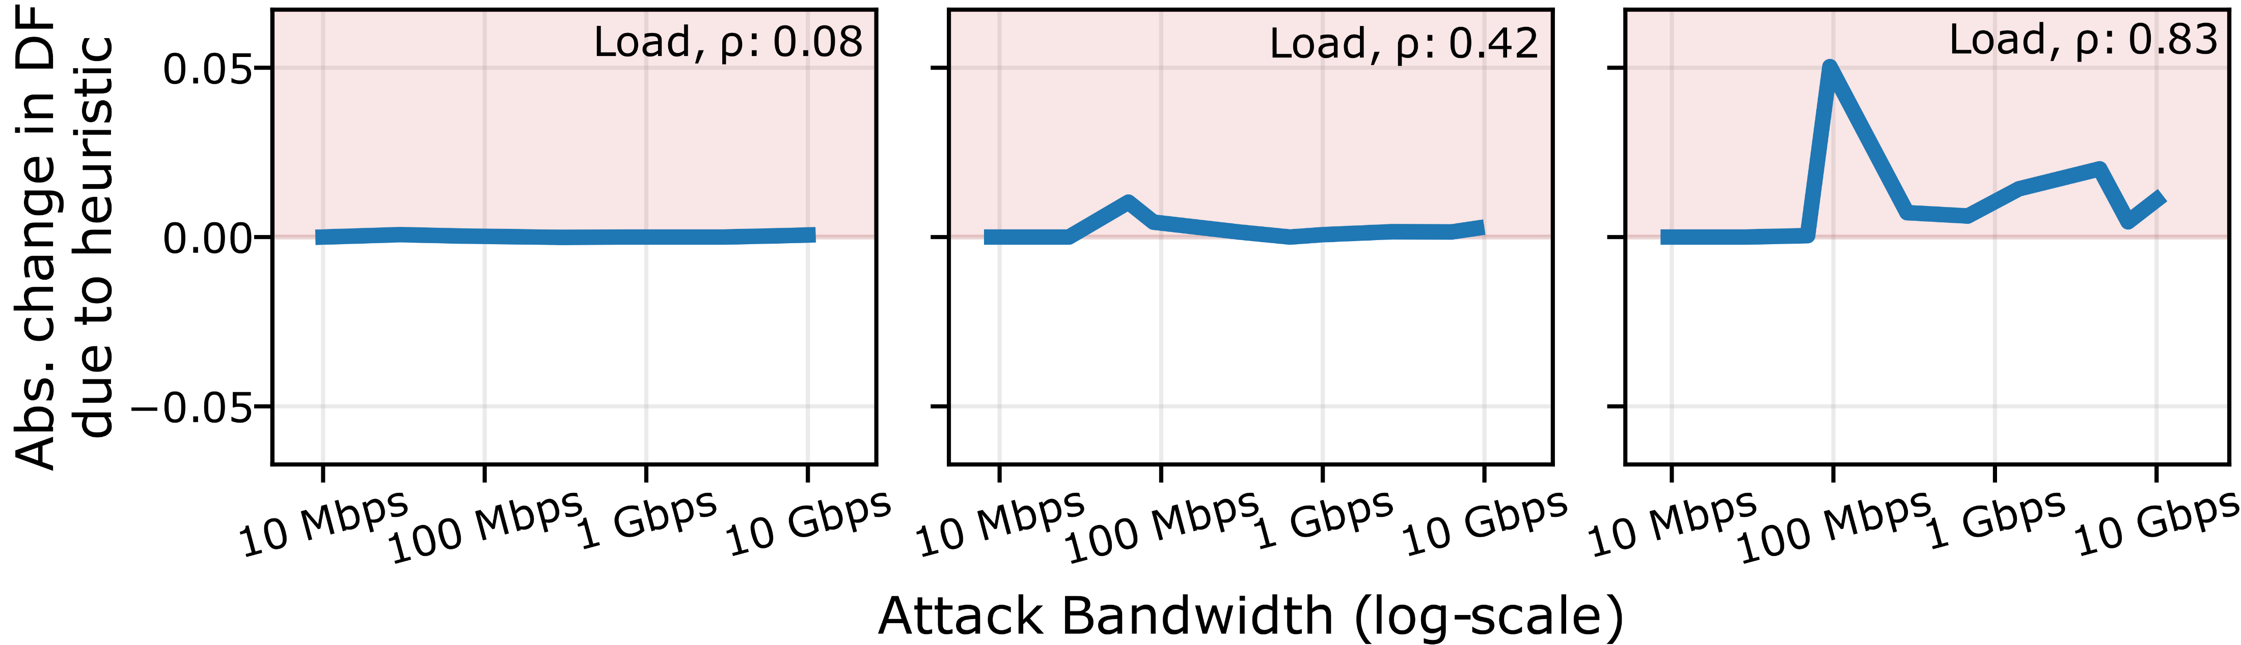
Heuristics: TCP Reassembly
The heuristic is accurate for innocent jobs, so despite knowing the actual and estimated job size distributions, the adversary can’t subvert it to a high degree

Slide 47
Fairness
Starvation
WSJF is work-conserving, so starvation-free when the system is underloaded or at capacity (normal operating conditions)
We do drop traffic when under attack (we have to!), but overall this is done in a way that minimizes the loss in goodput
Fairness
No fairness guarantees ☺
But this isn’t fundamental! For example, two preliminary ideas:
  Use FQ initially, switch to WSJF when goodput drops below some watermark
  Randomly choose between the top β% flows to serve (fairness), where β is a function of the goodput loss (ACA mitigation) (Courtesy Aditya Akella)

Slide 48
Potency of DoS Attacks
ACAs can be significantly more potent than Volumetric or Amplification Attacks
DoS Attack Class | Innocent traffic (bps) displaced for every 1 bps of attack traffic
Volumetric Attacks (e.g., DDoS) | 1
Amplification Attacks (e.g., DNS) | 3.8 – 360
ACAs | 300 (Pigasus¹), 184K (TSE²)
¹Zhao, Zhipeng, et al. "Achieving 100gbps intrusion prevention on a single server." 14th USENIX Symposium on Operating Systems Design and Implementation (OSDI 20). 2020.
²Csikor, Levente, et al. "Tuple space explosion: A denial-of-service attack against a software packet classifier." Proceedings of the 15th International Conference on Emerging Networking Experiments And Technologies. 2019.

Slide 49
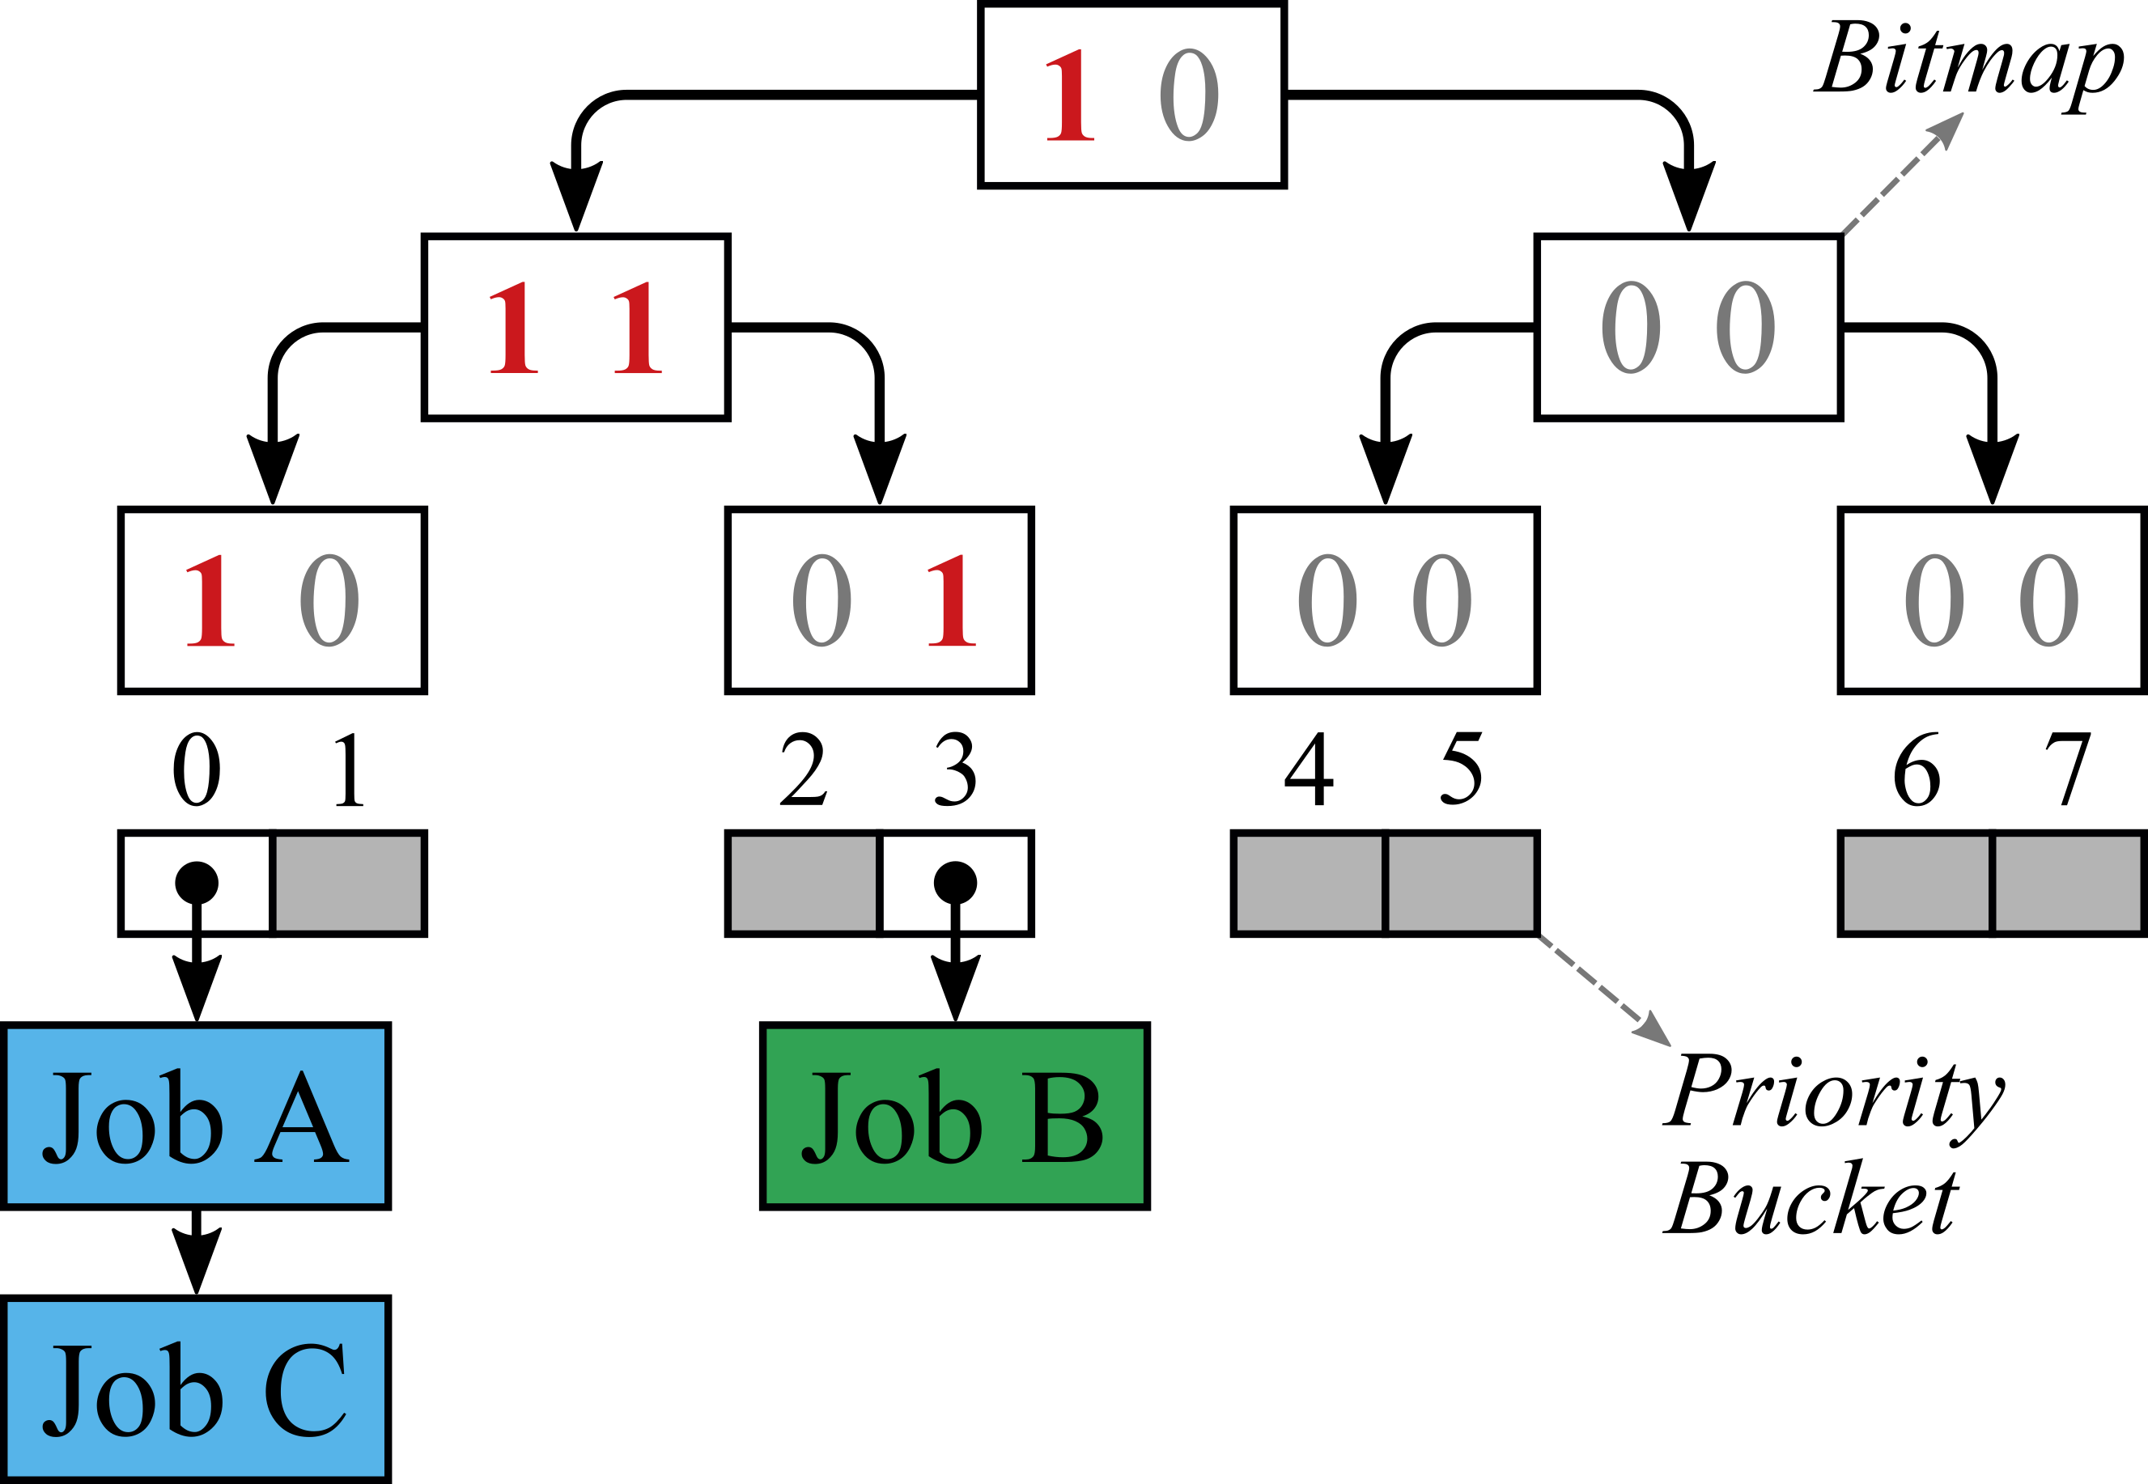
Adversary-Proof Heap: hFFS Queue

Slide 50
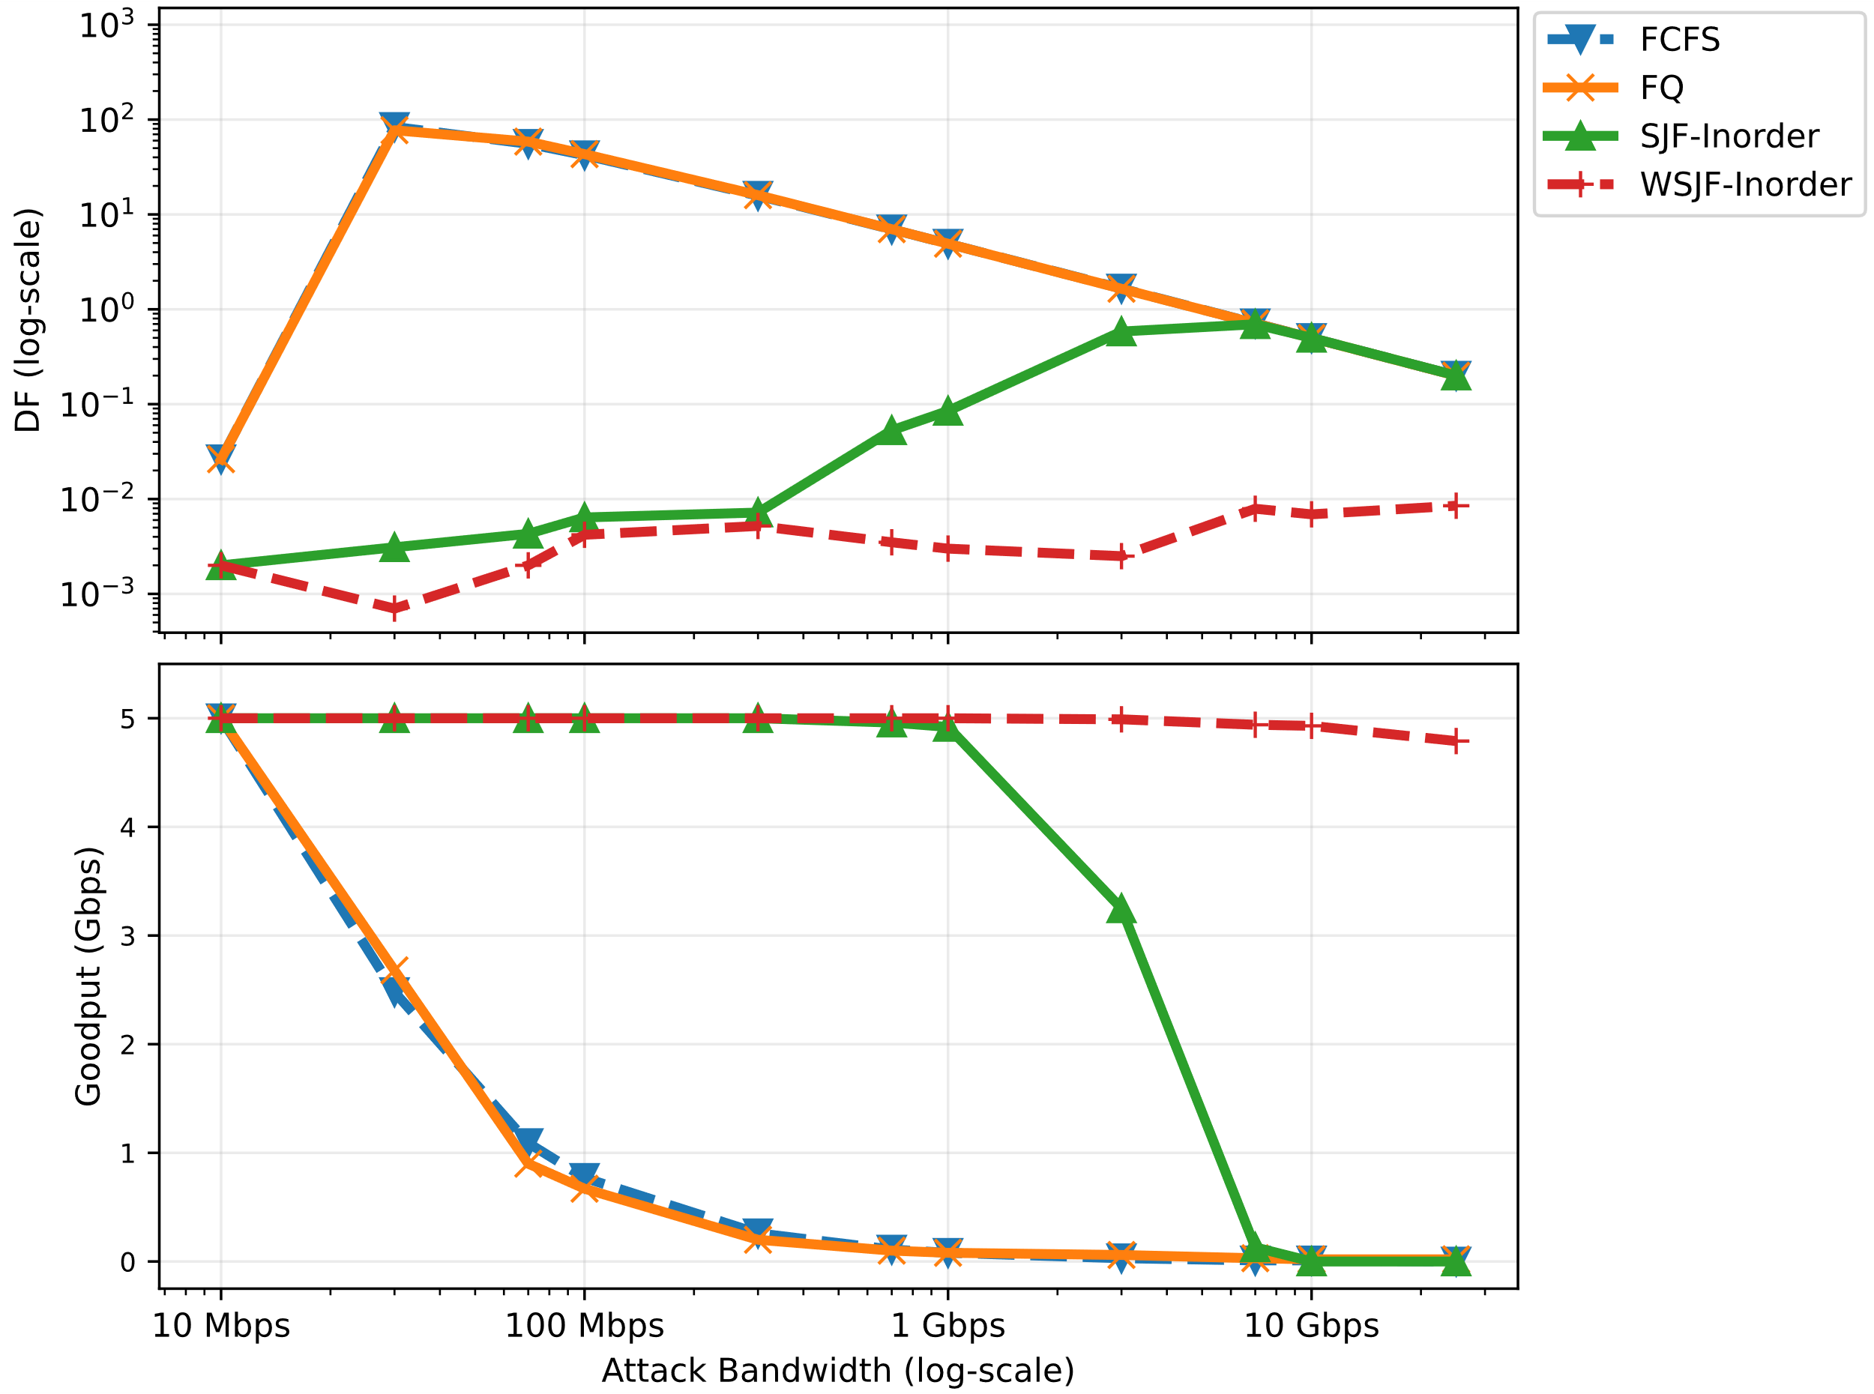
Simulated Results: FPGA-based TCP Reassembly

Slide 51
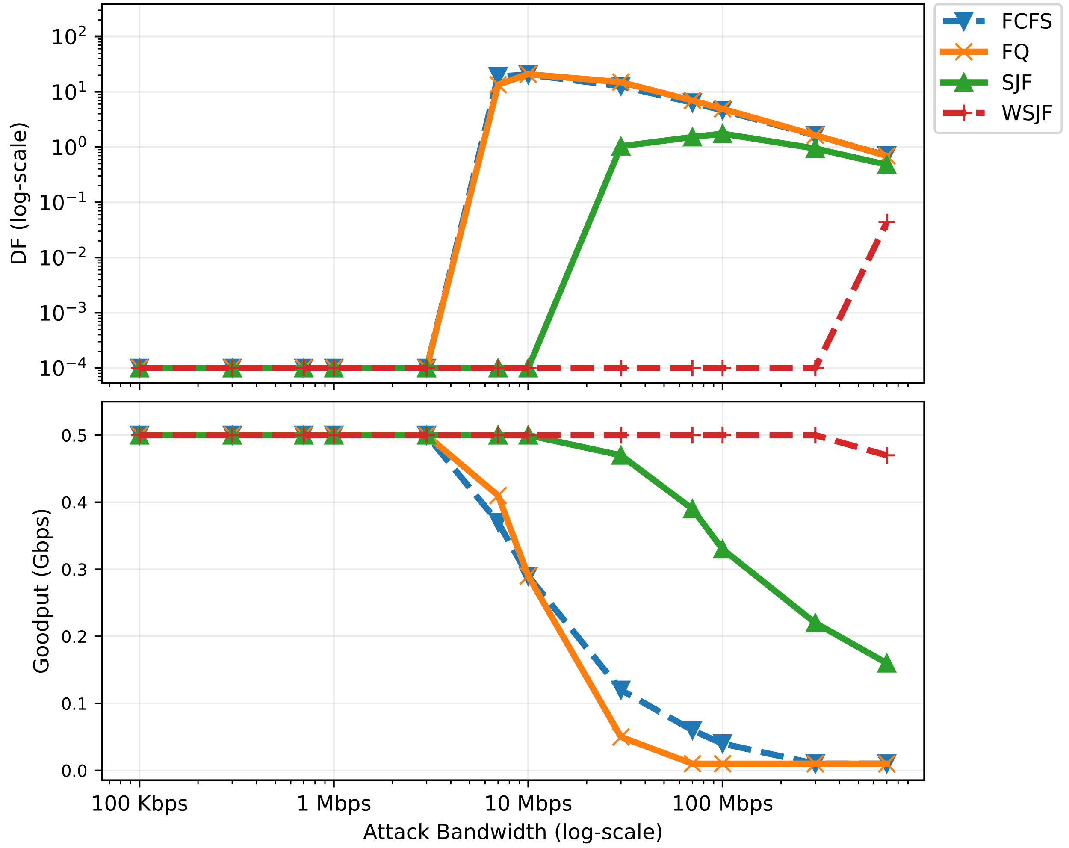
Simulated Results: Pigasus Full Matching

Slide 52
Shortest-Job First (SJF)
Policy: Prioritize packets with the smallest (initial) job size.

Slide 53
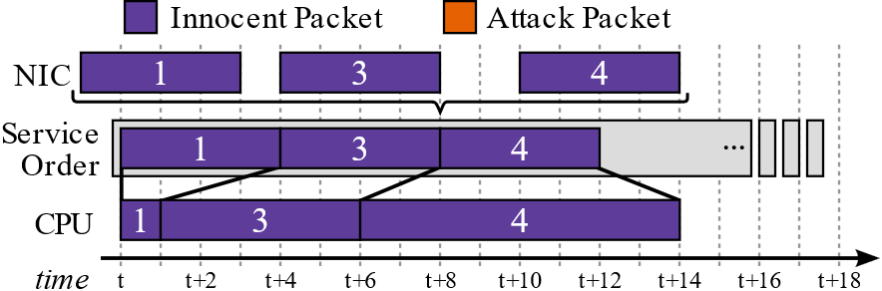
Shortest-Job First (SJF)
Policy: Prioritize packets with the smallest (initial) job size.
r_{I}
Innocent users

Slide 54
Shortest-Job First (SJF)
Policy: Prioritize packets with the smallest (initial) job size.
Packet size (P_{A})
Job size (J_{A})
r_{A}
Attacker
r_{I}
Innocent users

Slide 55
Shortest-Job First (SJF)
Policy: Prioritize packets with the smallest (initial) job size.
Packet size (P_{A}) | P_{min}
Job size (J_{A})
r_{A}
Attacker
r_{I}
Innocent users

Slide 56
Shortest-Job First (SJF)
Policy: Prioritize packets with the smallest (initial) job size.
What job size should I pick?
Packet size (P_{A}) | P_{min}
Job size (J_{A})
r_{A}
Attacker
r_{I}
Innocent users

Slide 57
Shortest-Job First (SJF)
Policy: Prioritize packets with the smallest (initial) job size.
Packet size (P_{A}) | P_{min}
Job size (J_{A}) | J*
r_{A}
Attacker
r_{I}
Innocent users

Slide 58
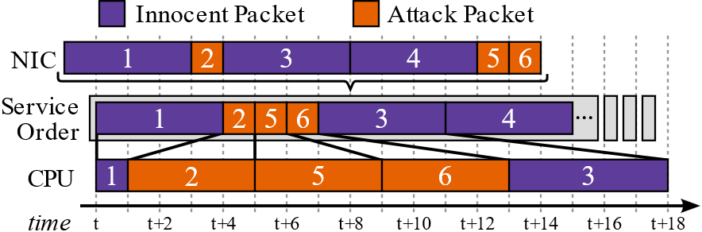
Shortest-Job First (SJF)
Policy: Prioritize packets with the smallest (initial) job size.
Packet size (P_{A}) | P_{min}
Job size (J_{A}) | J*
r_{A}
Attacker
r_{I}
Innocent users

Slide 59
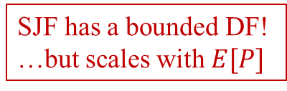

Shortest-Job First (SJF)
Policy: Prioritize packets with the smallest (initial) job size.
$$α_{SJF} ≤ \frac{\text{E}[P]}{P_{min}}$$
SJF has a bounded DF!
…but scales with $E[P]$
Packet size (P_{A}) | P_{min}
Job size (J_{A}) | J*
r_{A}
Attacker
r_{I}
Innocent users

Slide 60
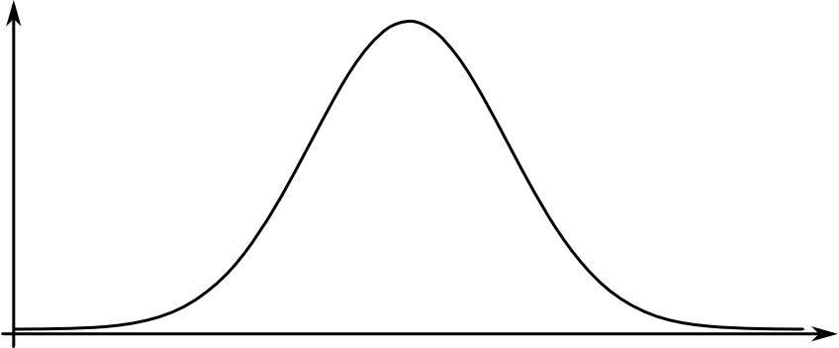
Shortest-Job First (SJF)
Job size distribution
PDF
Job size, J

Slide 61
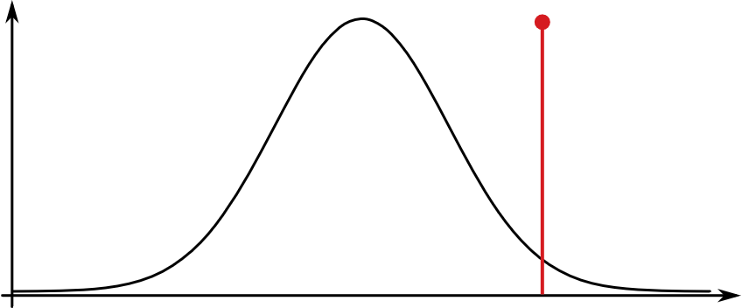
Shortest-Job First (SJF)
PDF
Job size, J
What if we pick a huge job size?

Slide 62
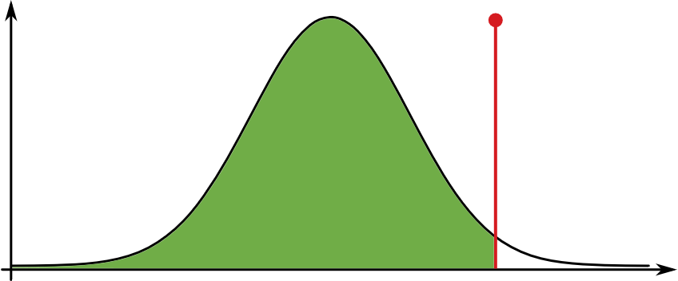
Shortest-Job First (SJF)
PDF
Job size, J
What if we pick a huge job size, J_{huge}?
⇒ Large fraction of innocent traffic will be served

Slide 63
Shortest-Job First (SJF)
PDF
Job size, J
What if we pick a huge job size, J_{huge}?
⇒ Large fraction of innocent traffic will be served

Slide 64
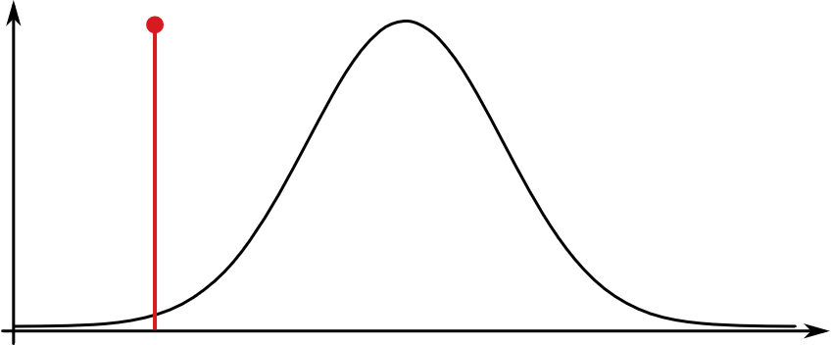
Shortest-Job First (SJF)
PDF
Job size, J
What if we pick a huge job size, J_{huge}?
⇒ Large fraction of innocent traffic will be served
What if we pick a very small job size, J_{small}?

Slide 65
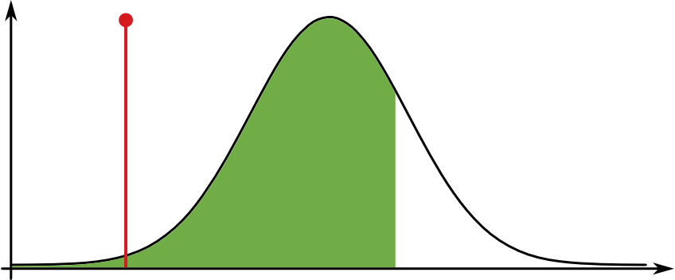
Shortest-Job First (SJF)
PDF
Job size, J
What if we pick a huge job size, J_{huge}?
⇒ Large fraction of innocent traffic will be served
What if we pick a very small job size, J_{small}?
⇒ System is underloaded w.r.t. jobs of size ≤ J_{small}, so more innocent traffic will be served

Slide 66
Shortest-Job First (SJF)
PDF
Job size, J
What if we pick a huge job size, J_{huge}?
⇒ Large fraction of innocent traffic will be served
What if we pick a very small job size, J_{small}?
⇒ System is underloaded w.r.t. jobs of size ≤ J_{small}, so more innocent traffic will be served

Slide 67
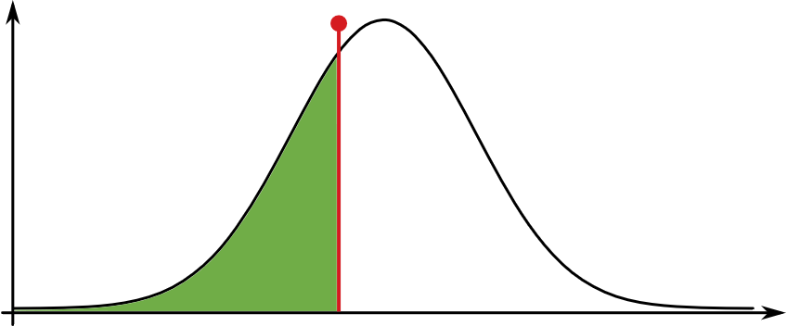
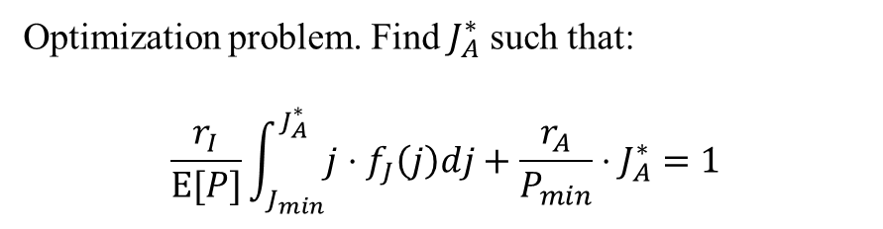
Shortest-Job First (SJF)
PDF
J_{A}*
Job size, J
Optimization problem. Find $J_{A}^{∗}$ such that:
$$\frac{r_{I}}{\text{E}[P]}\int_{J_{min}}^{J_{A}^{∗}}{j⋅f_{J}\left(j\right)dj}+\frac{r_{A}}{P_{min}}⋅J_{A}^{∗}=1$$

Slide 68
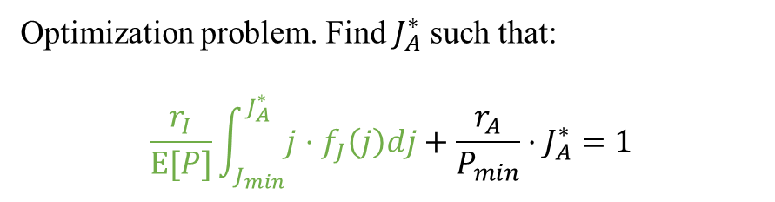
Shortest-Job First (SJF)
PDF
J_{A}*
Job size, J
Optimization problem. Find $J_{A}^{∗}$ such that:
$$\frac{r_{I}}{\text{E}[P]}\int_{J_{min}}^{J_{A}^{∗}}{j⋅f_{J}\left(j\right)dj}+\frac{r_{A}}{P_{min}}⋅J_{A}^{∗}=1$$
Innocent work served in 1s

Slide 69
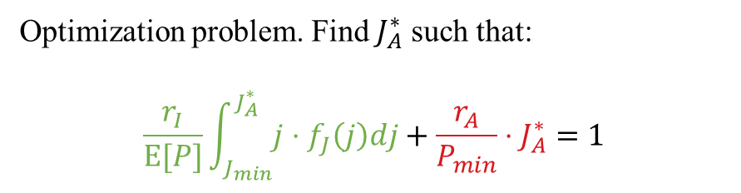
Shortest-Job First (SJF)
PDF
J_{A}*
Job size, J
Optimization problem. Find $J_{A}^{∗}$ such that:
$$\frac{r_{I}}{\text{E}[P]}\int_{J_{min}}^{J_{A}^{∗}}{j⋅f_{J}\left(j\right)dj}+\frac{r_{A}}{P_{min}}⋅J_{A}^{∗}=1$$
Innocent work served in 1s
Adversarial work served in 1s

Slide 70
Shortest-Job First (SJF)
PDF
J_{A}*
Job size, J
Optimization problem. Find $J_{A}^{∗}$ such that:
$$\frac{r_{I}}{\text{E}[P]}\int_{J_{min}}^{J_{A}^{∗}}{j⋅f_{J}\left(j\right)dj}+\frac{r_{A}}{P_{min}}⋅J_{A}^{∗}=1$$
Available service time (1s)
Innocent work served in 1s
Adversarial work served in 1s

Slide 71
Future Work
Is there a scheduling policy that is always DF-optimal?
Is there a systematic way to design job-size heuristics?
Can you do better if you can pre-empt jobs?

